Slide 1
BASICS OF ECONOMICS
UNIT- 1
BY
ARTI (MBA)
HINDU INSTITUTE OF MANAGEMENT & TECHNOLOGY, ROHTAK

Slide 2
Central Problems of an Economy
Rich or poor, developed or undeveloped, every economy must face three central problems. These are:
A) What to produce?
(B) How to produce? and
C) For whom to produce?

Slide 3
A) What to produce?
This problem has two dimensions:
(i) What goods are to be produced, and
(ii) In what quantity goods are to be produced.
(i) What Goods are to be Produced? Broadly, goods are classified as –
(a) Capital goods, and
(b) Consumer goods.

Slide 4
(B) How to Produce?
‘How to produce’ refers to the technique of production. Broadly, there are two techniques of production –
Labour-intensive technique
Capital-intensive technique.

Slide 5
(C) For Whom to Produce?
Owing to limited resources, an economy cannot produce goods for all sections of the society to the extent desired. Broadly, every economy has two sections of the society –
(i) The rich
(ii) The poor.

Slide 6
There are two add-on (additional) problems specific to underdeveloped economies like India.
These are:
(i)Problem of underutilization of resources.
(ii) Problem of growth of resources.

Slide 7
Production Possibility Curve (PPC) and Central Problems:
To illustrate and analyse the central problems, the economists use the technique of PPC (Production Possibility Curve), also called transformation curve or transformation line.

Slide 8
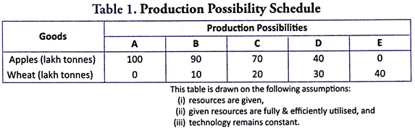

Slide 9
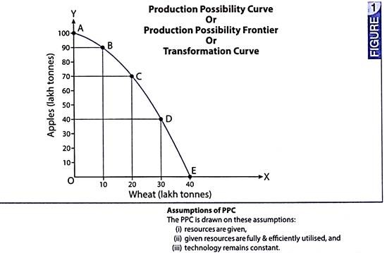

Slide 10
(1) PPC and What to Produce:
What to produce is essentially the problem of choice – what quantity of Good-X and Good-Y is to be produced? More of Good-X must lead to lesser production of Good-Y. Because, resources are assumed to fully and efficiently utilized, and technology is assumed to be constant. It shows that if production of Good-X is increased from OR to OS, the production of Good-Y must reduce from OC to OE. Because, some resources must be shifted from Y to X.

Slide 11
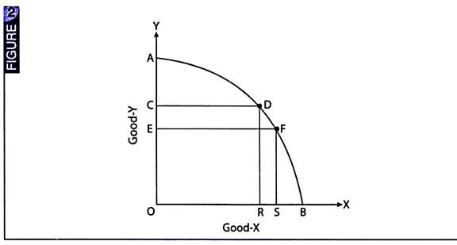

Slide 12
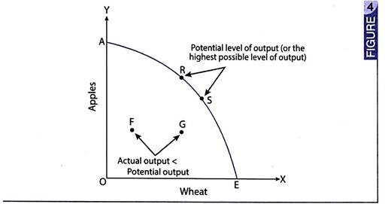
If resources are not fully and efficiently utilized Actual Level of Output < Potential Level of Output.
Actual Output = Potential Output, if the economy is operating on the PPC

Slide 13
Actual Output = Potential Output, if the economy is operating on the PPC (points R and S.
Actual Level of Output < Potential Level of Output, if the economy is operating inside the PPC

Slide 14
2) PPC and How to Produce:
The problem of how to produce relates to choice of technique. This problem is particularly serious in underdeveloped economies, facing a difficult choice between conventional technology.
A shift from conventional to modern technology would lead to a shift in PPC, but not without adding to the problem of unemployment.

Slide 15
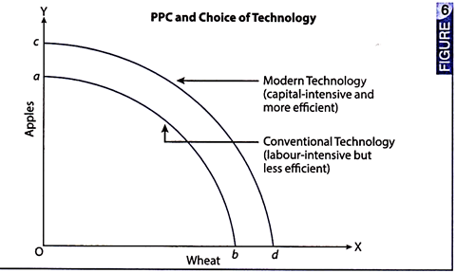

Slide 16
3) PPC and for Whom to Produce:
For whom to produce is the problem relating to the distribution of income. Skewed (unequal) distribution of income in favour of richer sections of the society would generate more surpluses (savings) for further investment. Accordingly, PPC would shift to the right, but poorer sections of the society would suffer deprivation.

Slide 17
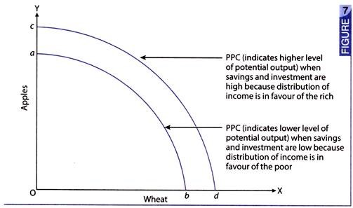

Slide 18
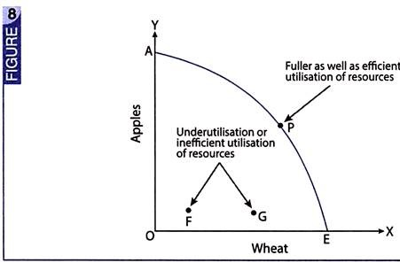
4) PPC and Underutilization of Resources:
In underdeveloped economies, resources are under utilised or are inefficiently utilized.

Slide 19
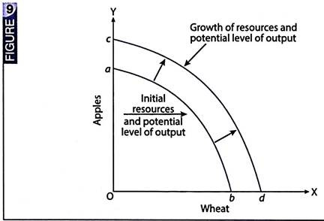
PPC and Growth of Resources:

Slide 20
When new resources are discovered, the economy would shift from ab to cd, implying a higher level of potential output. However, higher level of potential output is achievable only when all resources are fully and efficiently utilised.

Slide 21


